Slide 1
Stubs & Mocks
C Unit Testing

Slide 2
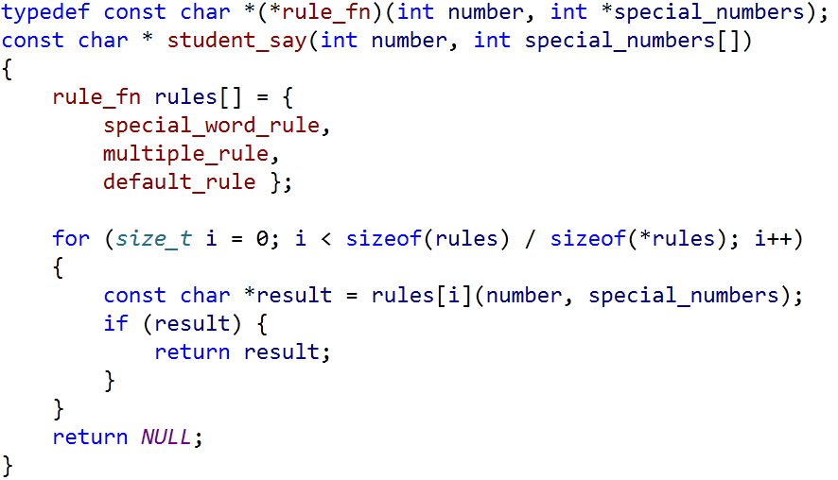
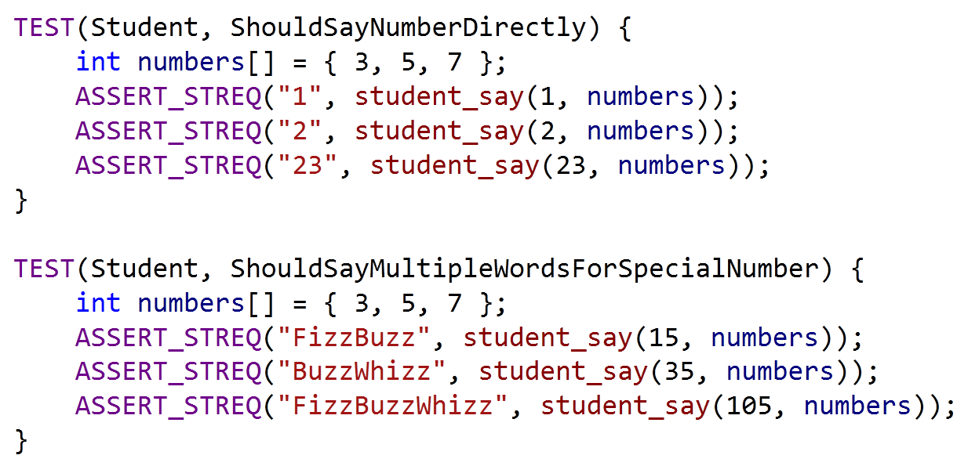

Applying Rules
Game Rules
How To Test student_say()

Slide 3
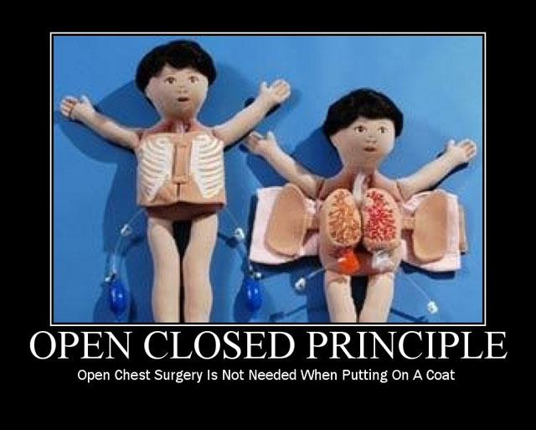
Open Closed Principle

Slide 4
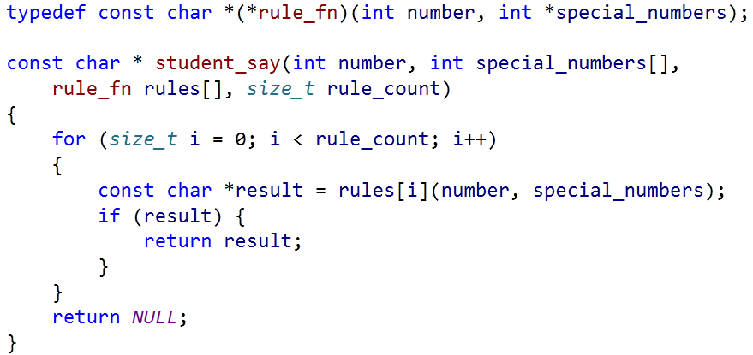
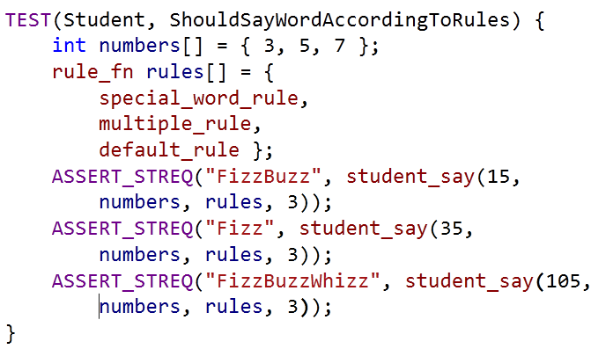
Injecting Rules
student_say no longer creates rules
Caller(Test) creates and injects rules into student_say
Injects

Slide 5
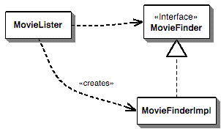
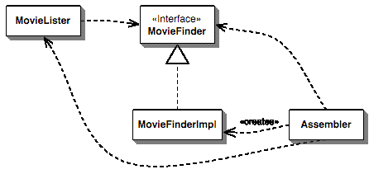
Dependency Injection
MovieLister uses MovieFinder
MovieLister creates MovieFinderImpl
MovieLister uses MovieFinder
Assembler creates MovieFinderImpl
Assembler inject MovieFinderImpl into MovieLister

Slide 6
Advantages
Dependency Injection decreases coupling between a class and its dependency.
Dependency injection allows a client to remove all knowledge of a concrete implementation that it needs to use.
Dependency injection can be used to externalize a system's configuration details into configuration files.
Dependency injection allows concurrent or independent development.
Easier to unit test in isolation using stubs or mock objects that simulate the dependent objects.

Slide 7
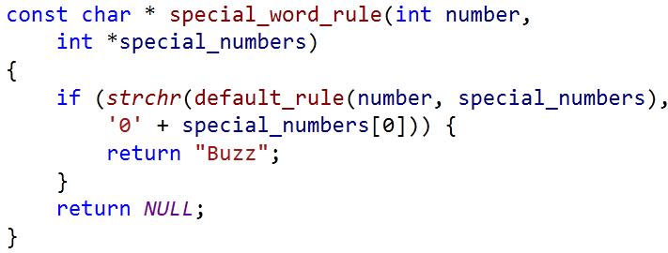
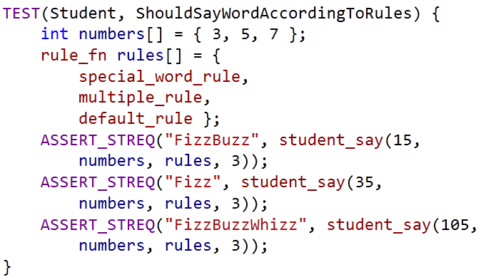
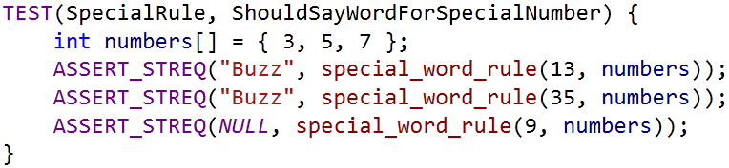
Rule Updated
学生报数时，如果所报数字包含了第一个特殊数，那么也不能说该数字，而是要说相应的单词，比如本例中第一个特殊数是3，那么要报13的同学应该说
Buzz
Fizz
System Under Test(SUT)

Slide 8
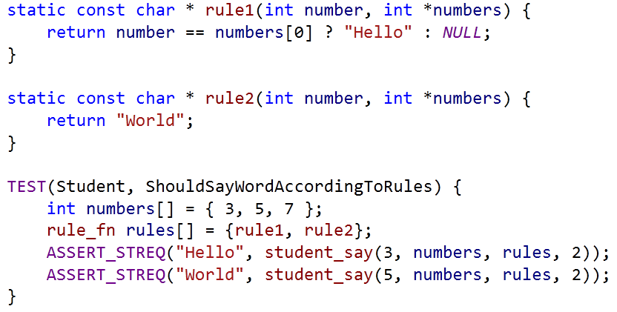
Using Fakes
Calls first rule with input number and special number
Returns result if it is not null
Otherwise try the next rule
Rule1 returns Hello if input equals first special number
Rule2 always returns World

Slide 9
Mocking
With Google Mock

Slide 10
WHY GOOGLE MOCK
You want to "mock out" your dependencies.
Your tests are slow as they depend on too many libraries or use expensive resources (e.g. a database).
Your tests are brittle as some resources they use are unreliable (e.g. the network, current time).
You want to test how your code handles a failure which is not easy to trigger.
Dependent Interface Does not yet exist or may change behavior.
Google Mock is easy to use as Google Test

Slide 11
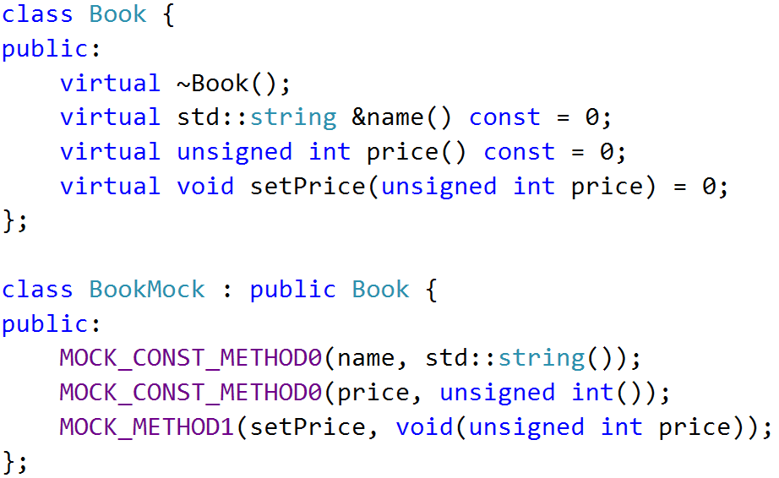

MOCK Object
A mock object implements the same interface as a real object (so it can be used as one), but lets you specify at run time how it will be used and what it should do

Slide 12
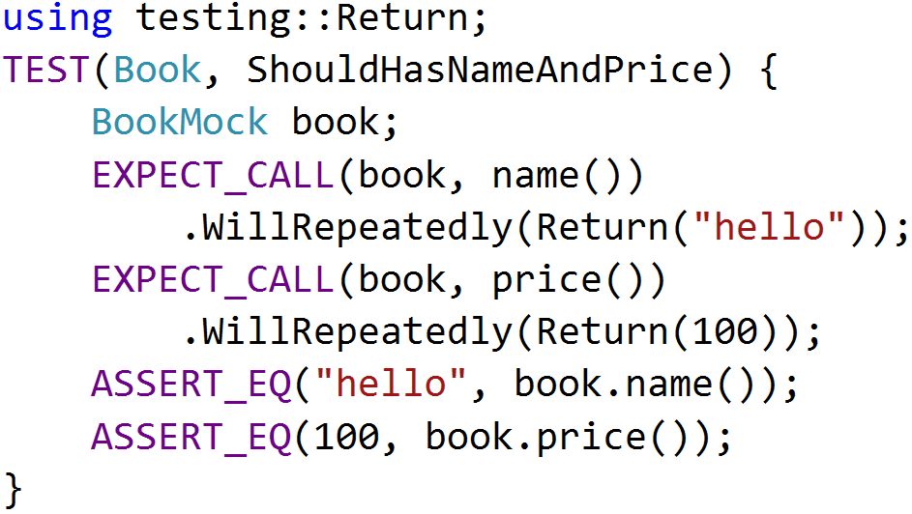
EXPECTATIONS
Use the EXPECT_CALL() macro to set an expectation on a mock method

Slide 13
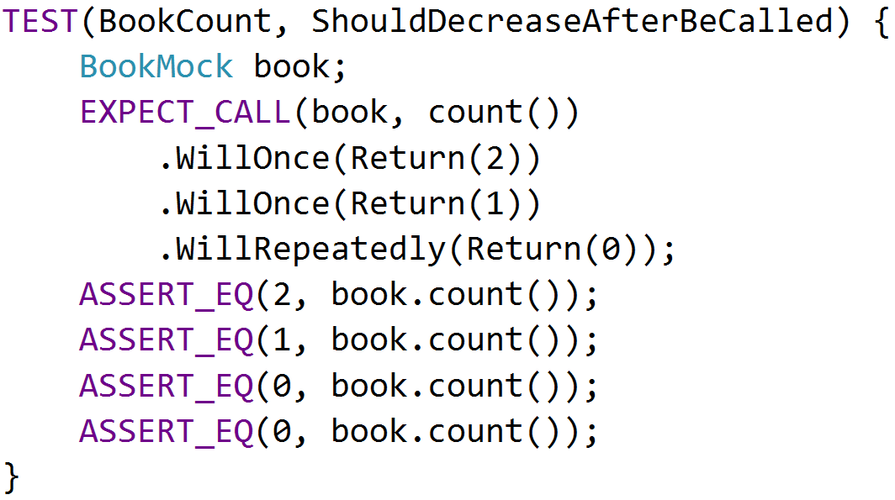
ACTIONS
The return value of mock functions can be specified by Will and Return Statement

Slide 14
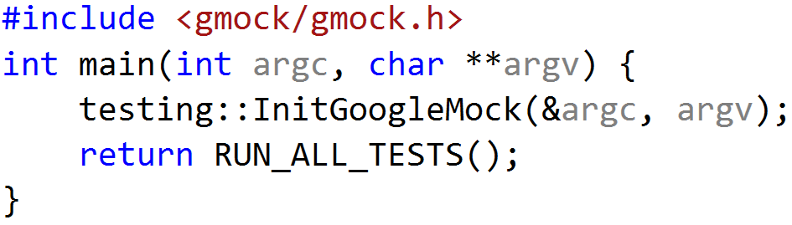
USING GMOCK
include <gmock/gmock.h>
write your mocks and tests
initialize gmock by InitGoogleMock()
call RUN_ALL_TESTS() in main() function
compile and run
InitGoogleMock() will automatically initialize Google Test

Slide 15
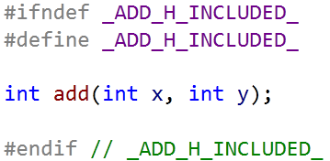
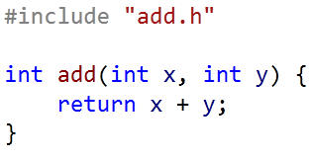
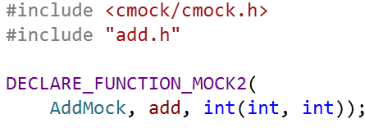
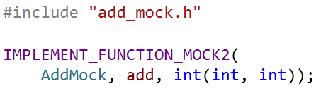
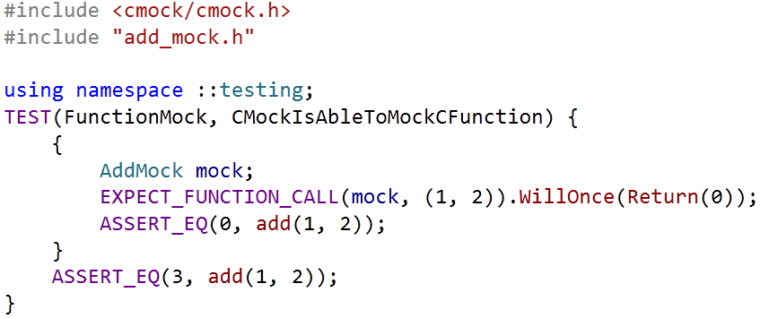
USING CMOCK – Google Mock Extension
add.h
add.c
add_mock.h
add_mock.cpp
add_test.cpp

Slide 16

EXERCISE
图书馆管理员(Librarian)会定期向书商(BookVendor)购买一些书籍来充实图书馆:
书商能够提供多种图书(附有价格)供管理员进行选择
管理员仅会挑选当前图书馆中不存在的书籍进行购买
管理员选好图书后, 会向书商支付所选书籍的总金额

Slide 17
Stubs Vs Mocks
Behavior Based Verfication

Slide 18
Test Doubles
Dummy objects are passed around but never actually used. Usually they are just used to fill parameter lists
Fake objects actually have working implementations, but usually take some shortcut which makes them not suitable for production
Stubs provide canned answers to calls made during the test, usually not responding at all to anything outside what's programmed in for the test
Mocks are objects pre-programmed with expectations which form a specification of the calls they are expected to receive

Slide 19
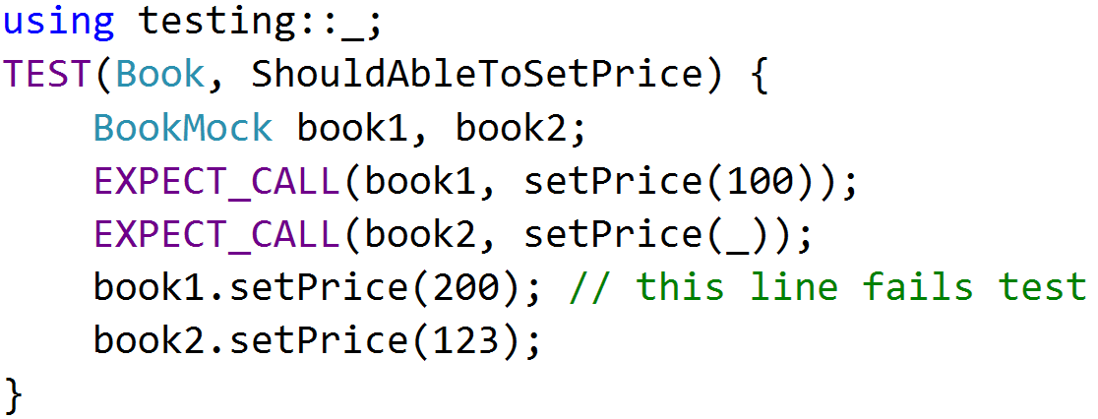
MATCHERS
When a mock function takes arguments, we can specify the expected arguments value
testing::_ will match any input arguments

Slide 20
Cardinalities
Use the Times() to specify the cardinality as it tells how many times the call should occur

Slide 21
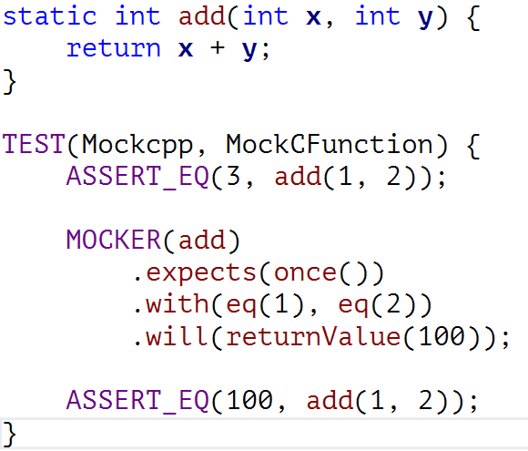
Mocking With Mockcpp
Mockcpp Mocker

Slide 22
EXERCISE
图书馆管理员(Librarian)会定期向书商(BookVendor)购买一些书籍来充实图书馆:
书商能够提供多种图书(附有价格)供管理员进行选择
管理员仅会挑选当前图书馆中不存在的书籍进行购买
管理员选好图书后, 会向书商支付所选书籍的总金额
Notes:
通过EXPECT对传入参数设置期望
通过Times限制付款次数

Slide 23
Reference
http://github/DT/tree/master/02-GMock
https://code.google.com/p/googlemock/wiki/ForDummies
https://code.google.com/p/googlemock/wiki/CheatSheet
https://code.google.com/p/googlemock/wiki/CookBook
https://code.google.com/p/googlemock/wiki/FrequentlyAskedQuestions
https://code.google.com/p/mockcpp/

Slide 24
THANK YOU
For questions or suggestions:
Wu Kun
kunwu@thoughtworks.com

